Slide 1

Financial Accounting
Jahangir Tanveer
Lecture 2

Slide 2
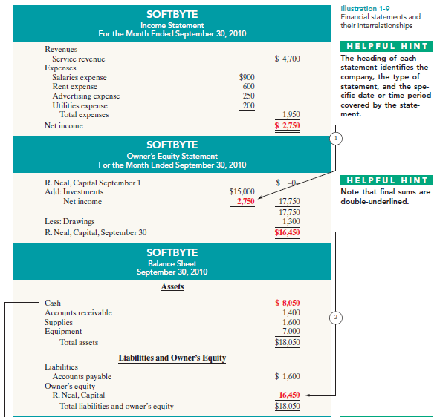

Slide 3
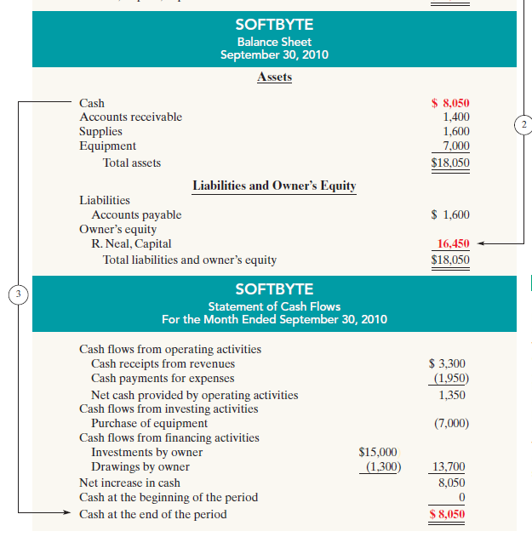

Slide 4
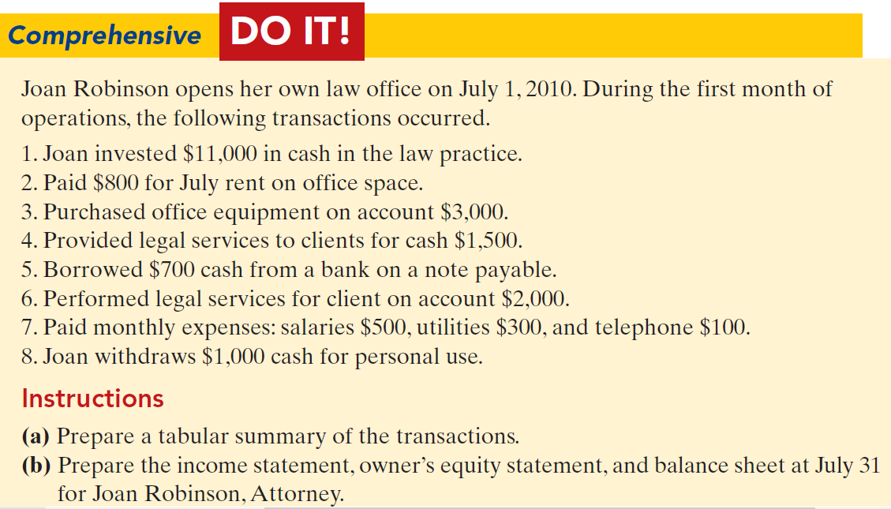

Slide 5
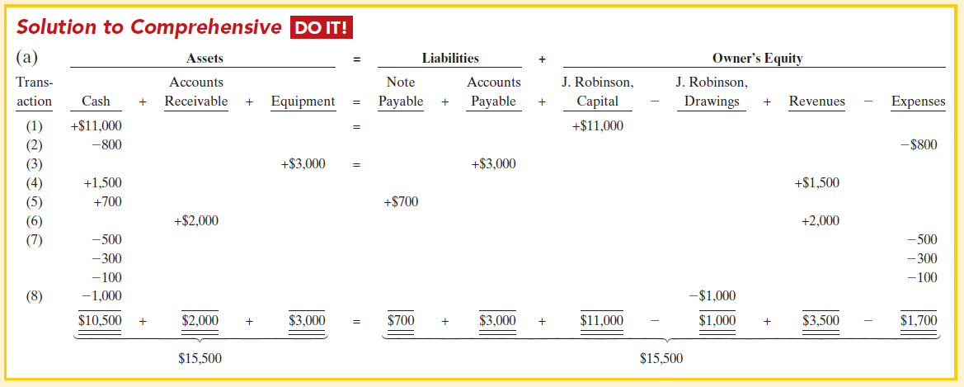

Slide 6
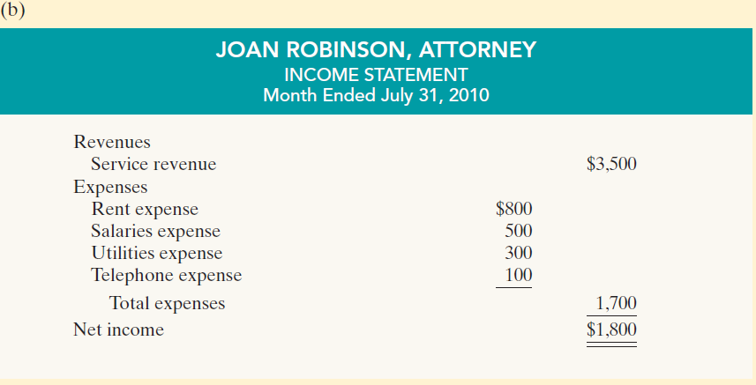

Slide 7
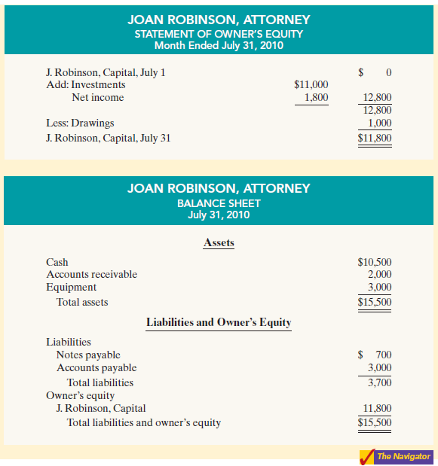

Slide 8
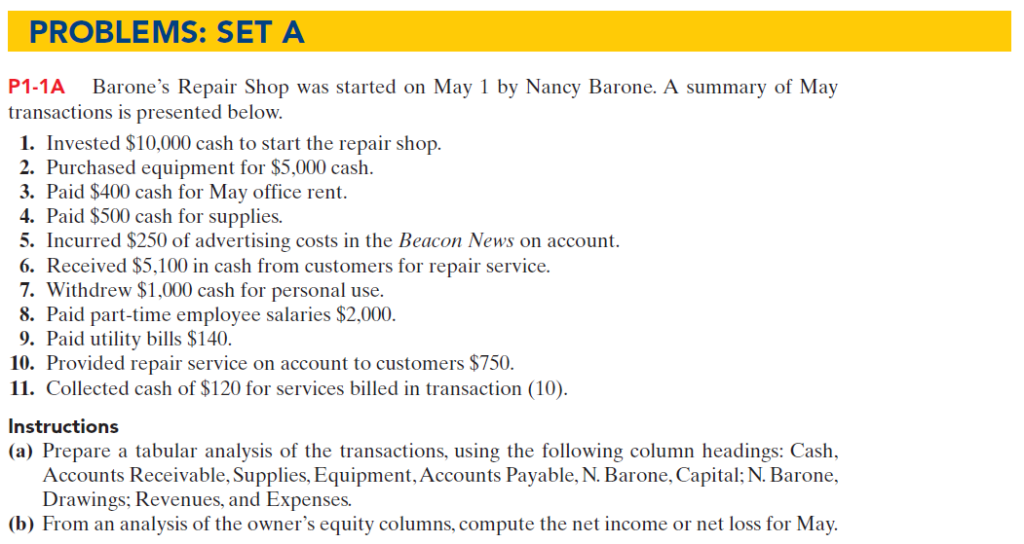
Assignment

Slide 9
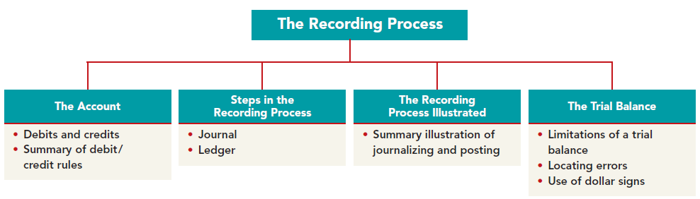
Chapter No.2

Slide 10
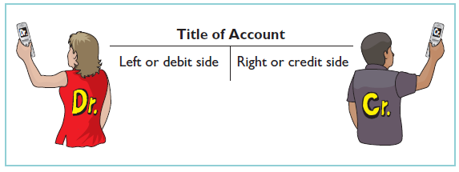
An account is an accounting record of increases and decreases in a specific asset, liability, or owner’s equity item. For example, Softbyte (the company discussed in Chapter 1) would have separate accounts for Cash, Accounts Receivable, Accounts Payable, Service Revenue, and Salaries Expense. In its simplest form, an account consists of three parts: (1) a title, (2) a left or debit side, and (3) a right or credit side. Because the format of an account resembles the letter T, we refer to it as a T account. Illustration 2-1 shows the basic form of an account.

Slide 11
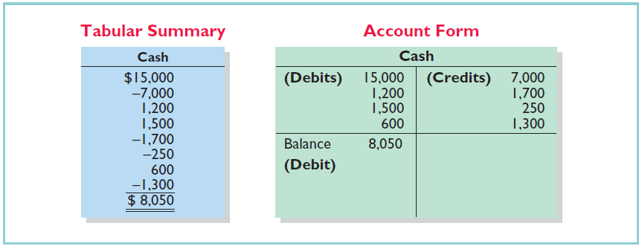
Debits and Credits
Debit Dr Credit Cr
Left side Right side

Slide 12


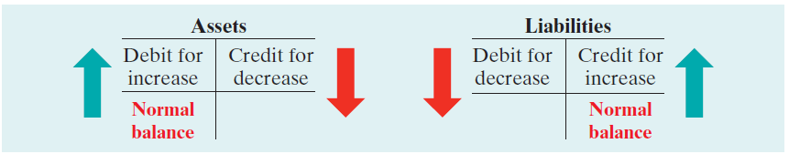

DEBIT AND CREDIT PROCEDURE
Assets and Liabilities

Slide 13


DEBIT AND CREDIT PROCEDURE
Owner’s Equity

Slide 14
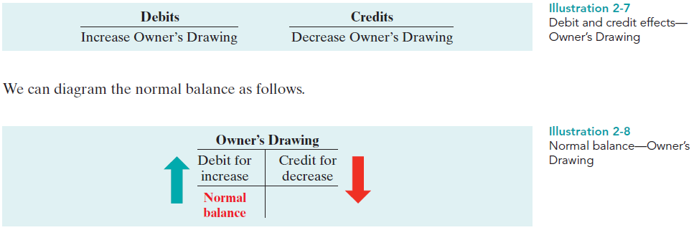
DEBIT AND CREDIT PROCEDURE
Owner’s Drawing

Slide 15

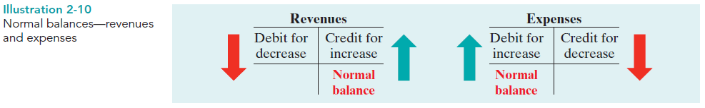
DEBIT AND CREDIT PROCEDURE
Revenues and Expenses

Slide 16
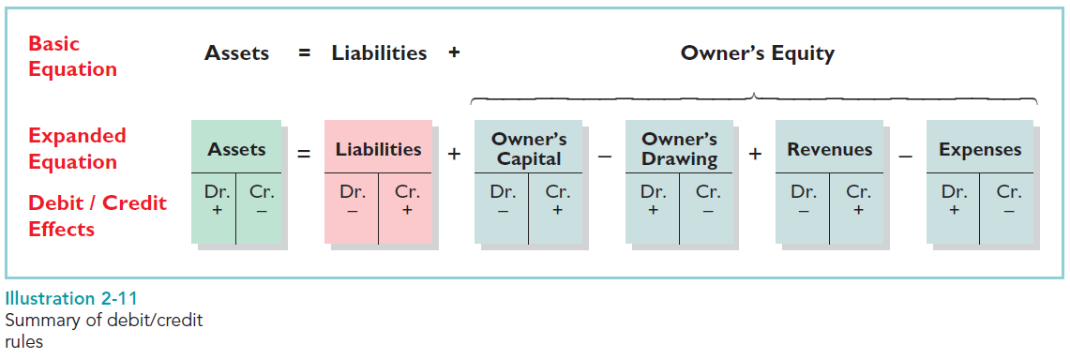
Summary of Debit/Credit Rules

Slide 17
1. Analyze each transaction for its effects on the accounts.
2. Enter the transaction information in a journal.
3. Transfer the journal information to the appropriate accounts in the ledger.

Slide 18
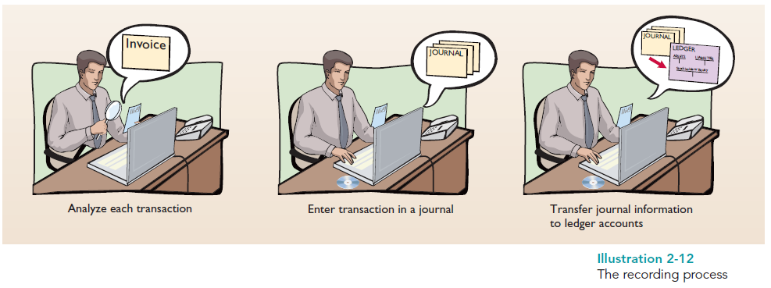
The recording process begins with the transaction. Business documents, such as a sales slip, a check, a bill, or a cash register tape, provide evidence of the transaction. The company analyzes this evidence to determine the transaction’s effects on specific accounts. The company then enters the transaction in the journal. Finally, it transfers the journal entry to the designated accounts in the ledger.

Slide 19
The Journal
Companies initially record transactions in chronological order (the order in which they occur).Thus, the journal is referred to as the book of original entry. For each transaction the journal shows the debit and credit effects on specific accounts.
The journal makes several significant contributions to the recording process:
1. It discloses in one place the complete effects of a transaction.
2. It provides a chronological record of transactions.
3. It helps to prevent or locate errors because the debit and credit amounts for each entry can be easily compared.

Slide 20
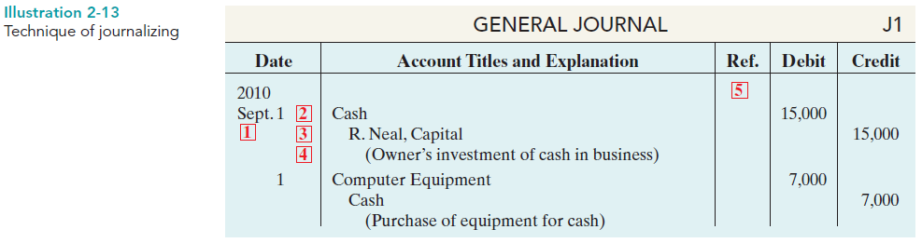
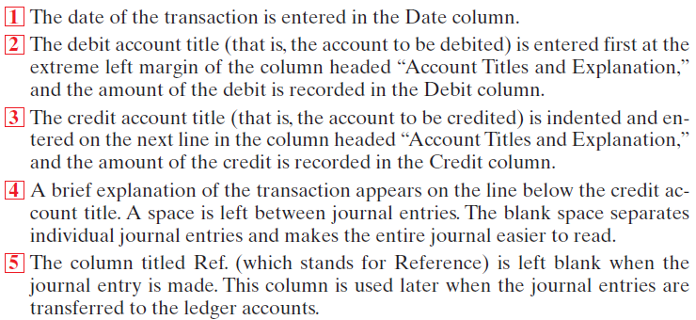
JOURNALIZING

Slide 21
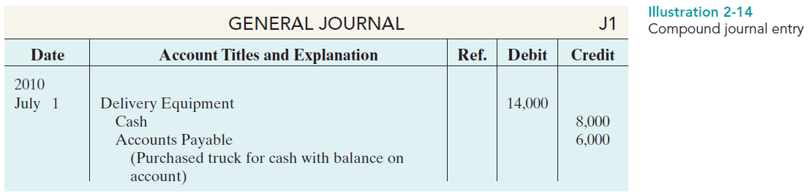
SIMPLE AND COMPOUND ENTRIES

